Slide 1

High permittivity garnet ferrites for LTCC compatible circulators
LEGAY Mathis
15th October 2026
Noordwijk, Netherlands
Richard LEBOURGEOIS, Rassoul MANSOUR – Thales Research & Technology
Daniel CABAN-CHASTAS, Quentin TODOLI – Thales DMS
Vincent LAUR – Lab-Sticc

Slide 2


Summary
Context & Objectives
Ferrites synthesis
Design and fabrication of the circulator
Measurements
Conclusion & Perspectives

Slide 3
Summary
Context & Objectives
Ferrites synthesis
Design and fabrication of the circulator
Measurements
Conclusion & Perspectives

Slide 4
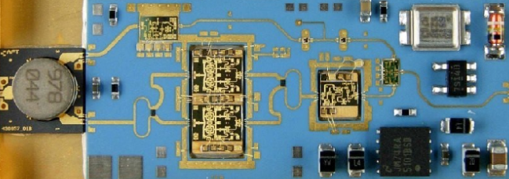
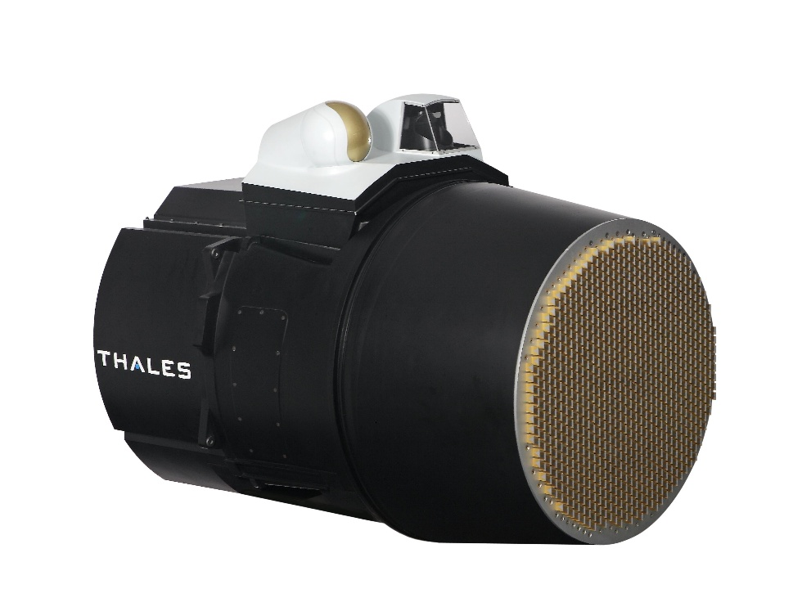
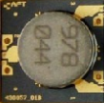
I. Context & objectives
Application’s field: telecommunication and radar systems
T/R module
Circulator
Bulky
Expensive
Active Electronically Scanned Antennas
  Miniaturizing the components and better integration into systems

Slide 5
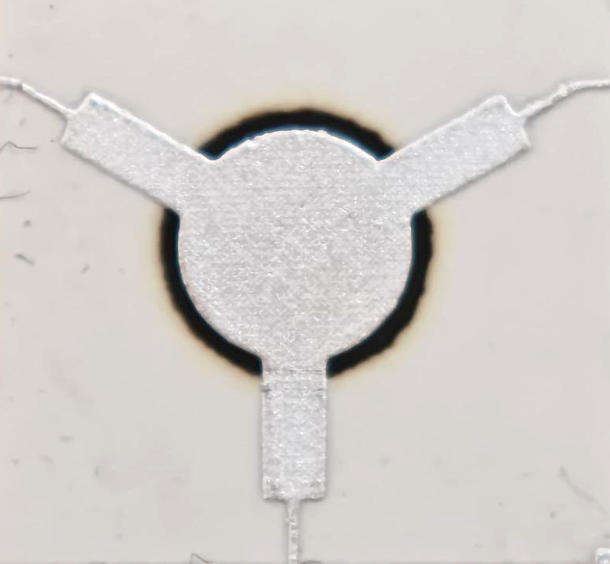
I. Context & objectives
Circulator
  Passive and non-reciprocal component
  Main function: routing microwave signals
    Possibility of simultaneous transmission/reception
    Equipment protection
Phenomenon of signal circulation
2
TX
1
Radome
Radiating element
Circulator
HPA
TX
2
TX
TX
1
RX
3
RX
RX
LNA
RX
RX
3
  Circulator: a crucial element of a T/R module

Slide 6
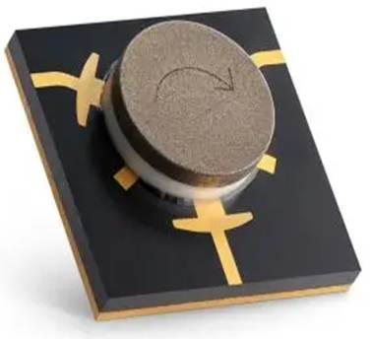
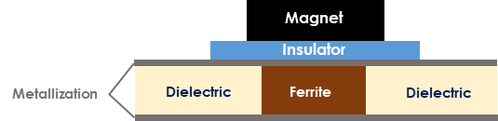

I. Context & objectives
Circulator structure
  Ferrite responsible of the circulation phenomenon when submitted to an external magnetic field
  Adding a magnet on the top
Y-junction using microstrip technology
Ferrite choice
  Ferrites choice depending on frequency application
L band
S band
C band
X band
Ku band
K band
Ka band
Q band
V band
Garnet
Ms : 300 to 2000 G
Spinel
Ms : 1900 to 5000 G
Hexaferrites
Ms : 3000 to 5000 G

Slide 7
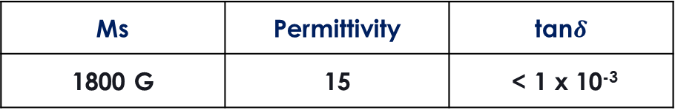
I. Context & objectives
Yttrium Iron Garnet - Y₃Fe₅O₁₂
  Most common garnet
  Properties in line with a X band application
Ms | Permittivity | tan$δ$
1800 G | 15 | < 1 x 10⁻³
Sintering temperature
1500 °C
BUT
Very high temperature
Objectives of the study
  Modify the properties of the YIG to:
Reduce the size of a circulator
Increase the permittivity of the ferrite
Simplify the manufacturing process
Ferrite compatible with LTCC process

Slide 8
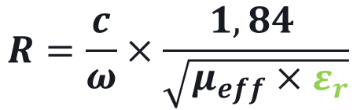
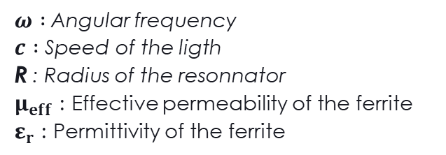
I. Context & objectives
How to reduce the size of circulator?
  Size of a Y-junction resonator gouverned by :
$ω :$Angular frequency
$c :$ Speed of the ligth
R : Radius of the resonnator
$μ_{eff}$ : Effective permeability of the ferrite
$ε_{r}$ : Permittivity of the ferrite
$$R=\frac{c}{ω}×\frac{1,84 }{\sqrt{μ_{eff}×ε_{r}}}$$
Bosma equation¹ :
Increase the permittivity of the ferrite
1. H. Bosma, “On Stripline Y-Circulation at UHF,” IEEE TRANSACTIONS ON MICROWAVE THEORY AND TECHNIQUES, p. 12.

Slide 9
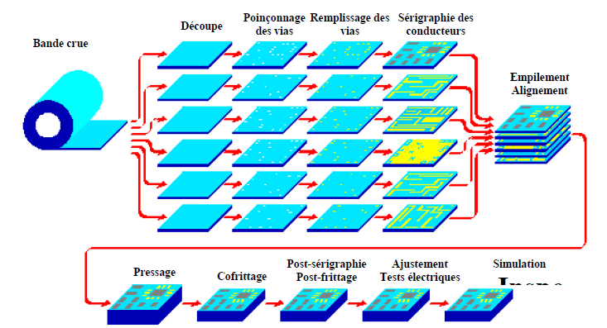
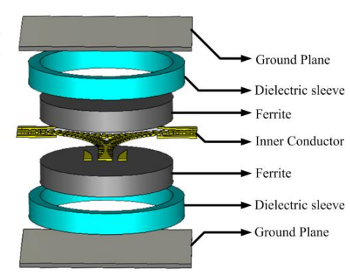
I. Context & objectives
Circulator manufacturing
Assembly
LTCC process
  Complex manufacturing
    Multimaterials
    Machining/gluing
    Large size
    Expensive
  LTCC : Low Temperature Co-fired Ceramic
    Single step fabrication at 950°C
    No additionnal machining needed
Cutting
Punching of the vias
Filling of the vias
Screenprinting of the connectors
Green tape
Magnet
Stacking the alignments
Easier, faster and cheaper than assembling
Pressing
Cofiring
Post firing
Electronical adjustment
Simulation
Magnet
Need to have a « compatible » LTCC ferrite
Reduce the sintering temperature of the ferrite to be able to use the LTCC process

Slide 10
Summary
Context & Objectives
Ferrites synthesis
Design and fabrication of the circulator
Measurements
Conclusion

Slide 11
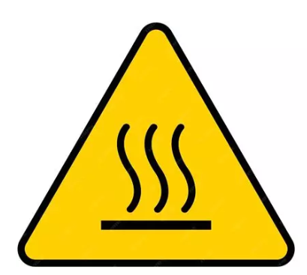
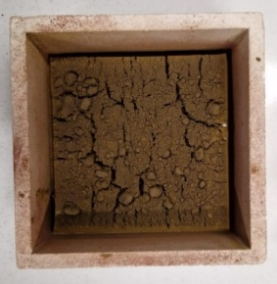
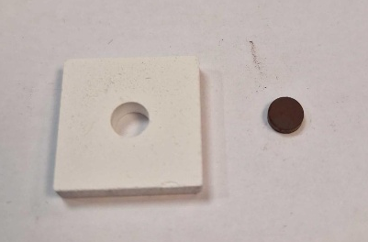
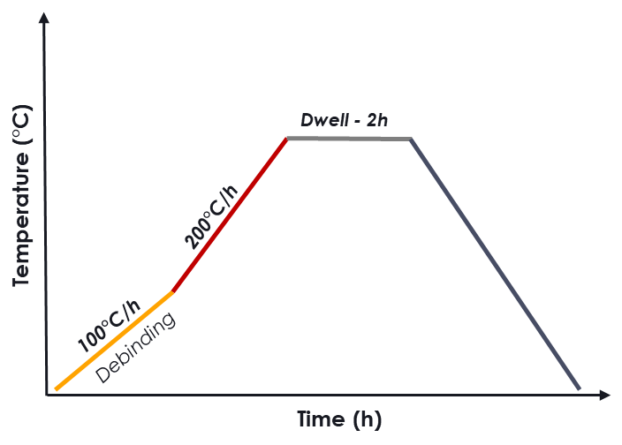
II. Ferrite synthesis
How to manage YIG properties?
  Adjustment of properties via cationic substitutions
Decrease of the sintering temperature
Increase in permittivity
Y₃Fe₅O₁₂
Y³⁺
Bi³⁺
Ca²⁺
Fe³⁺
Cu²⁺
Sn⁴⁺
O₁₂
Y_{2,05}Bi_{0,7}Ca_{0,25}Fe_{4,65}Cu_{0,05}Sn_{0,3}O₁₂
Substitutions
Stabilize saturation magnetization
Conventional ceramic process
Powder preparation
Shaping
Heat treatment
Powders oxides weighing
Mixing/milling
First heat treatment
Uniaxial pressing
Sintering at high temperature
Densification and completing the phase formation
Formation of the magnetic phase

Slide 12

II. Ferrite synthesis
Substituted YIG properties
 | Sintering temperature | ε’ at 9.3GHz | tanδ at 9.3 GHz | Ms (G)
Y₃Fe₅O₁₂ | 1500°C | 15 | 1.10⁻³ | 1800
Y_{2,05}Bi_{0,7}Ca_{0,25}Fe_{4,65}Cu_{0,05}Sn_{0,3}O₁₂
( )
( )
($≈$)
1900
( )
950°C
21
3.10⁻³
Objectives
Decrease of the sintering temperature
Increase of the permittivity
Conservation of low losses
Stabilization of the saturation magnetization
✓
✓
✓
✓

Slide 13
Summary
Context & Objectives
Ferrites synthesis
Design and fabrication of the circulator
Measurements
Conclusion & Perspectives

Slide 14





III. Design and fabrication of circulator
Contribution of the high permittivity of the ferrite
  Comparison of the dimensions of a circulator with a pure YIG disk with those using a high permittivity substituted garnet
  Y-junction using microstrip technology optimized at 10GHz using ANSYS HFSS and Maxwell 3D
  Ferrite disk of radius R is surrounded by a commercial dielectric with ε’= 20
$$Dielectric$$
$$Dielectric$$
Pure YIG
ε’=15
tanδ = 1.10⁻³
Substituted YIG
ε’=21
tanδ = 3.10⁻³
$$Ferrite$$
$$Ferrite$$
A 23% decrease in surface area
ε’=20
tanδ = 1.10-3
ε’=20
tanδ = 1.10-3
Design of a circulator with high permittivity ferrite
  Magnetostatic-electromagnetic co-simulations conducted to determine the magnet geometry required to generate a homogeneous field within the ferrite → Samarium-Cobalt magnet

Slide 15
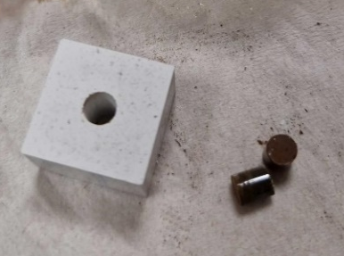
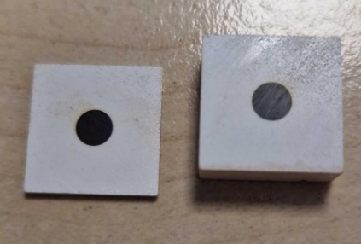
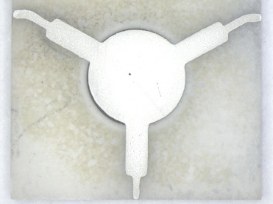
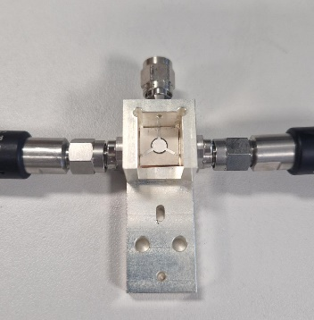
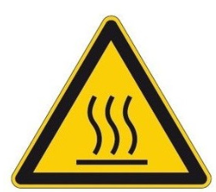
III. Design and fabrication of circulator
Before LTCC process : cofiring preliminary test
  Need to check if materials can be cofired
1 Pressing/massive cofiring
  2 massive pieces formed by uniaxial pressing : Commercial dielectric + ferrite cylinder
  Co-firing at 950°C
2 Preparation of substrates and deposition of conductive lines
  Substrate Cutting/polishing
  Screen printing deposition of conductive lines
3 Gluing in measurement cell
950°C

Slide 16
Summary
Context & Objectives
Ferrites synthesis
Design and fabrication of the circulator
Measurements
Conclusion & Perspectives

Slide 17
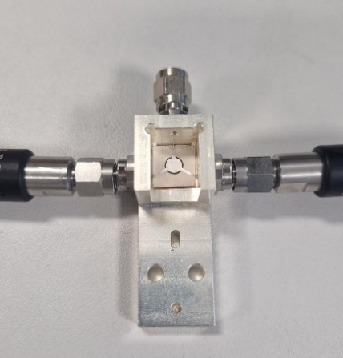
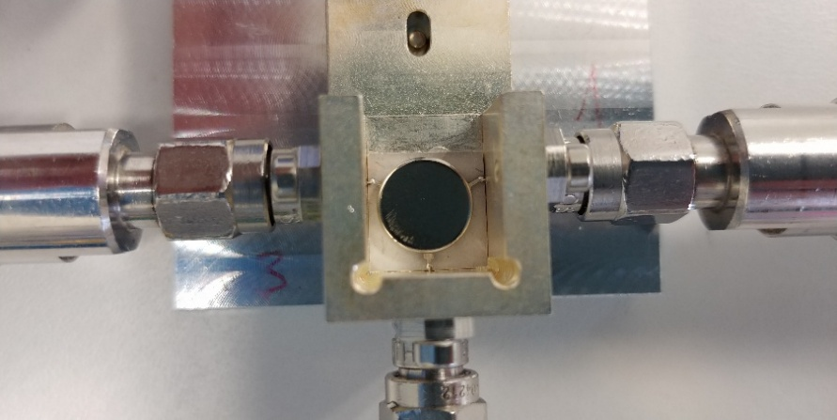
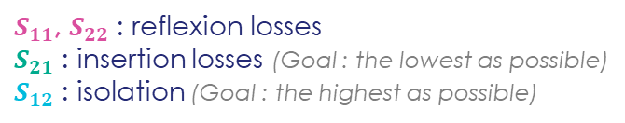

IV. Measurements
Measurement setup
  Circulator connected to a Vectorial Network Analyzer
S-parameters
Load of 50 Ω
50 Ω
2
1
Circulator with metallization
Magnet
$$S=\left[\begin{matrix}S_{11} & S_{12} \\ S_{21} & S_{22}\end{matrix}\right]$$
  $S_{11}$, $S_{22}$ : reflexion losses
  $S_{21}$ : insertion losses (Goal : the lowest as possible)
  $S_{12}$ : isolation (Goal : the highest as possible)

Slide 18
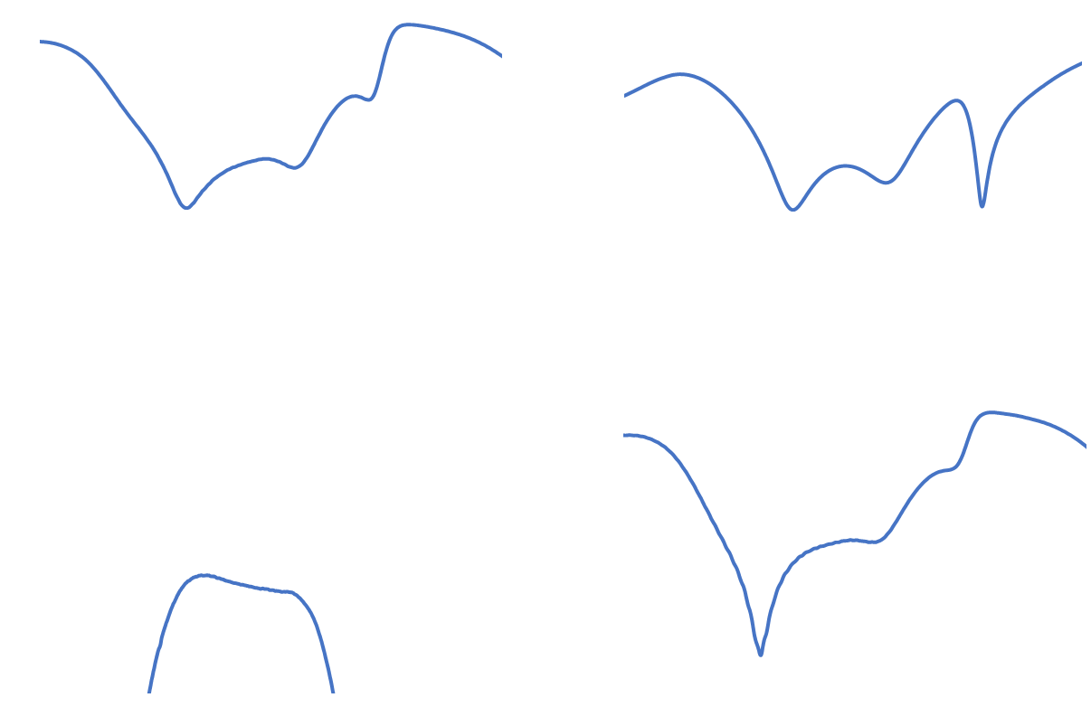
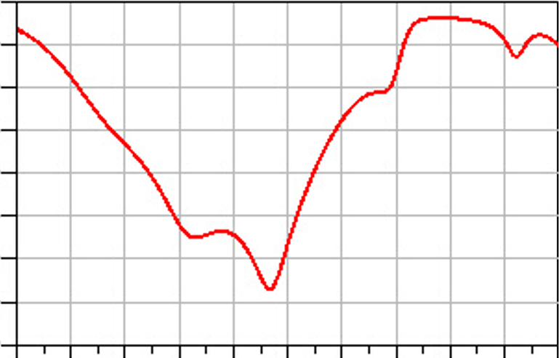
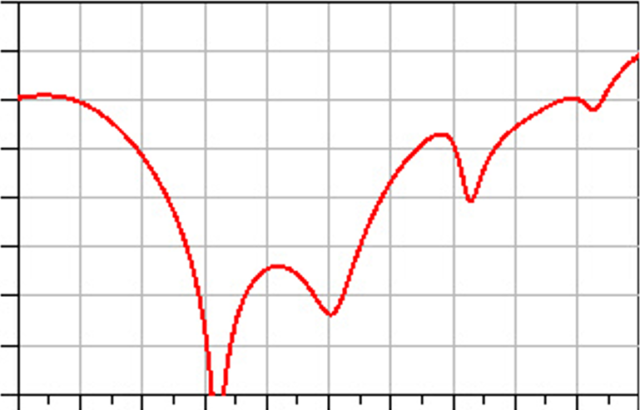
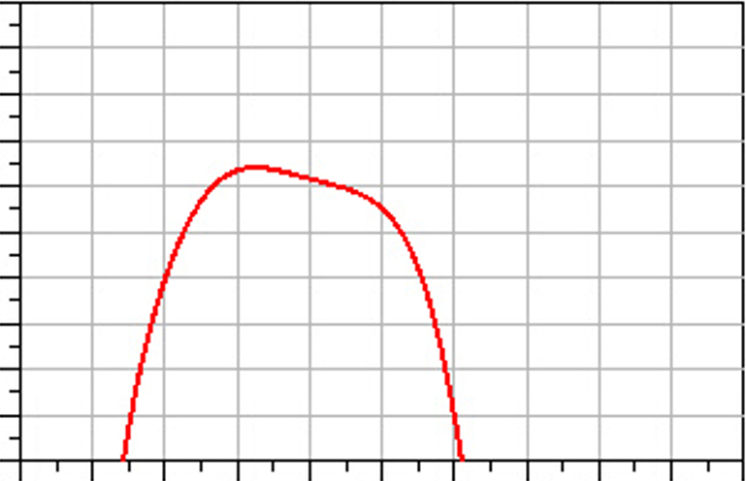
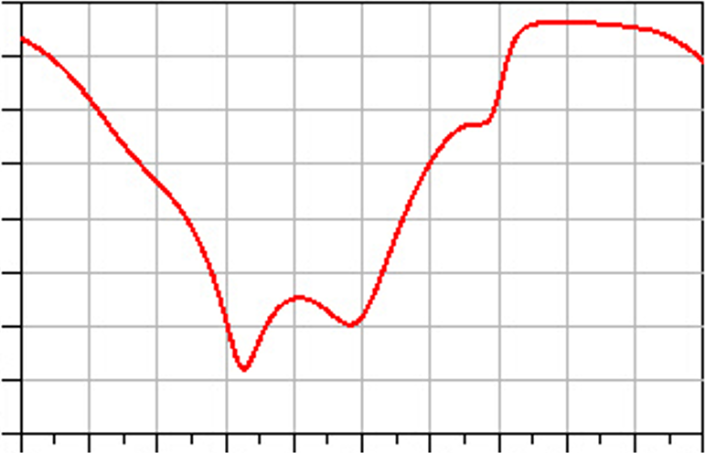

IV. Measurements
$$S=\left[\begin{matrix}S_{11} & S_{12} \\ S_{21} & S_{22}\end{matrix}\right]$$
0
Adaptation
0
Isolation
- 5
Reflexion losses
- 5
Isolation
- 10
- 10
- 15
- 15
Simulation
- 20
- 20
dB(S(1,1))
dB(S(1,2))
Strong non-reciprocity
Relative bandwith = 48,9% centered at 9,2 GHz
Insertion losses < 0,6 dB with minimum at 0,36dB
- 25
- 25
- 30
- 30
- 35
- 35
- 40
- 40
5
6
7
8
9
10
11
12
13
14
15
5
6
7
8
9
10
11
12
13
14
15
Frequency (GHz)
Frequency (GHz)
0
Insertion losses
0
Adaptation
- 0.1
Insertion losses
- 5
Reflexion losses
Measurements
- 0.2
- 10
- 0.3
Good agreement with simulations
Relative bandwith = 41,6% (slightly shifted to 9,7 GHz for S₁₂)
Insertion losses slightly increased up to 0,6 dB
- 0.4
- 15
- 0.5
- 20
dB(S(2,1))
dB(S(2,2))
- 0.6
- 25
- 0.7
- 30
- 0.8
- 0.9
- 35
- 1.0
- 40
5
6
7
8
9
10
11
12
13
14
15
5
6
7
8
9
10
11
12
13
14
15
Frequency (GHz)
Frequency (GHz)

Slide 19
Summary
Context & Objectives
Ferrites synthesis
Design and fabrication of the circulator
Measurements
Conclusion & Perspectives

Slide 20
V. Conclusion & Perspectives
Synthesis of a substituted YIG with upgraded properties
Fabrication of a demonstrator with this substituted YIG
  Successfully co-fired at 950°C with the commercial dielectric
Good electromagnetic performances (low insertion losses and high isolation)
Y_{2,05}Bi_{0,7}Ca_{0,25}Fe_{4,65}Cu_{0,05}Sn_{0,3}O₁₂
( )
( )
( = )
1900
( = )
950°C
21
3.10⁻³
  Pave the way for the development of low-cost, compact, and efficient circulators
Perspectives :
  Material development: increase more ferrite permittivity
  Process development: produce a circulator with the complete LTCC process (cofiring all materials including metallic parts)

Slide 21
Thank you

